Slide 1
PiTendo
Colman Jerry

Slide 2
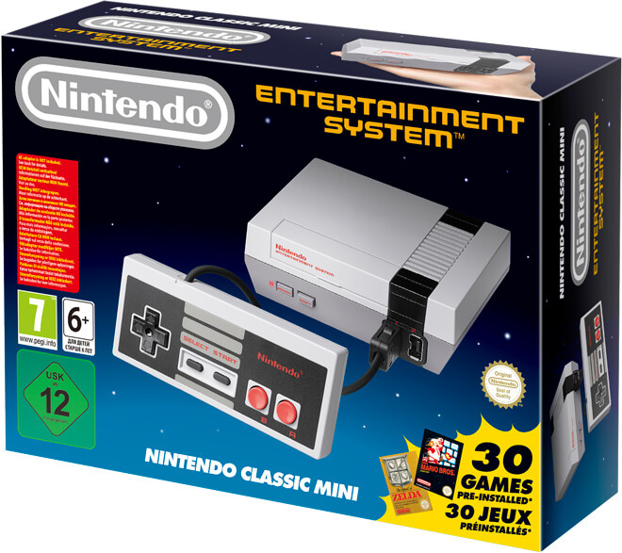
Overview
Decided to pursue this project after Nintendo discontinued the NES Classic despite supply never meeting demand
Retailed for $60 and came with 30 games pre-installed; system not designed to pay and install additional games
Units selling online for hundreds of dollars
Wanted something similar with more games and more features available

Slide 3
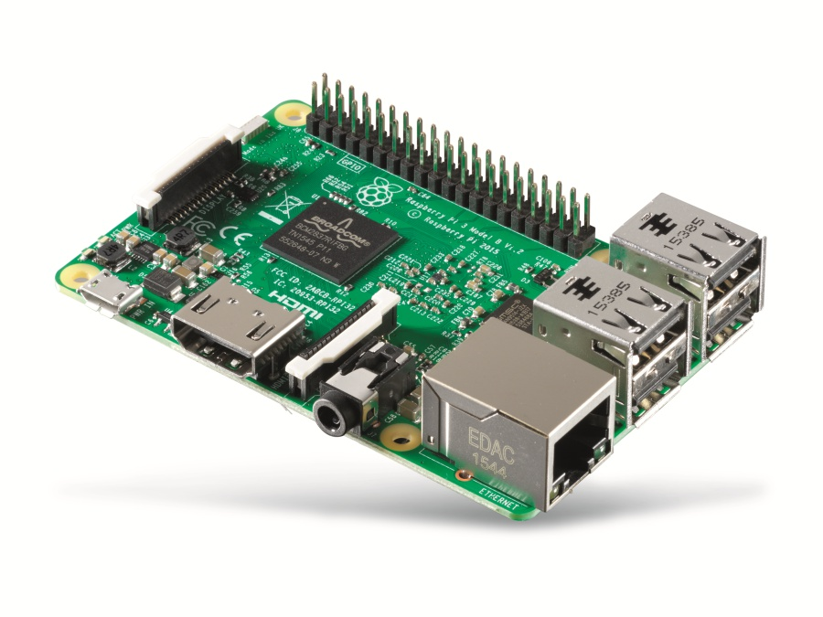
Components
Raspberry Pi 3 kit
Mausberry Circuit
Extender Cables
USB Hub
Game Controllers
Assortment of wires soldering related tools
Broken NES console to house it all

Slide 4
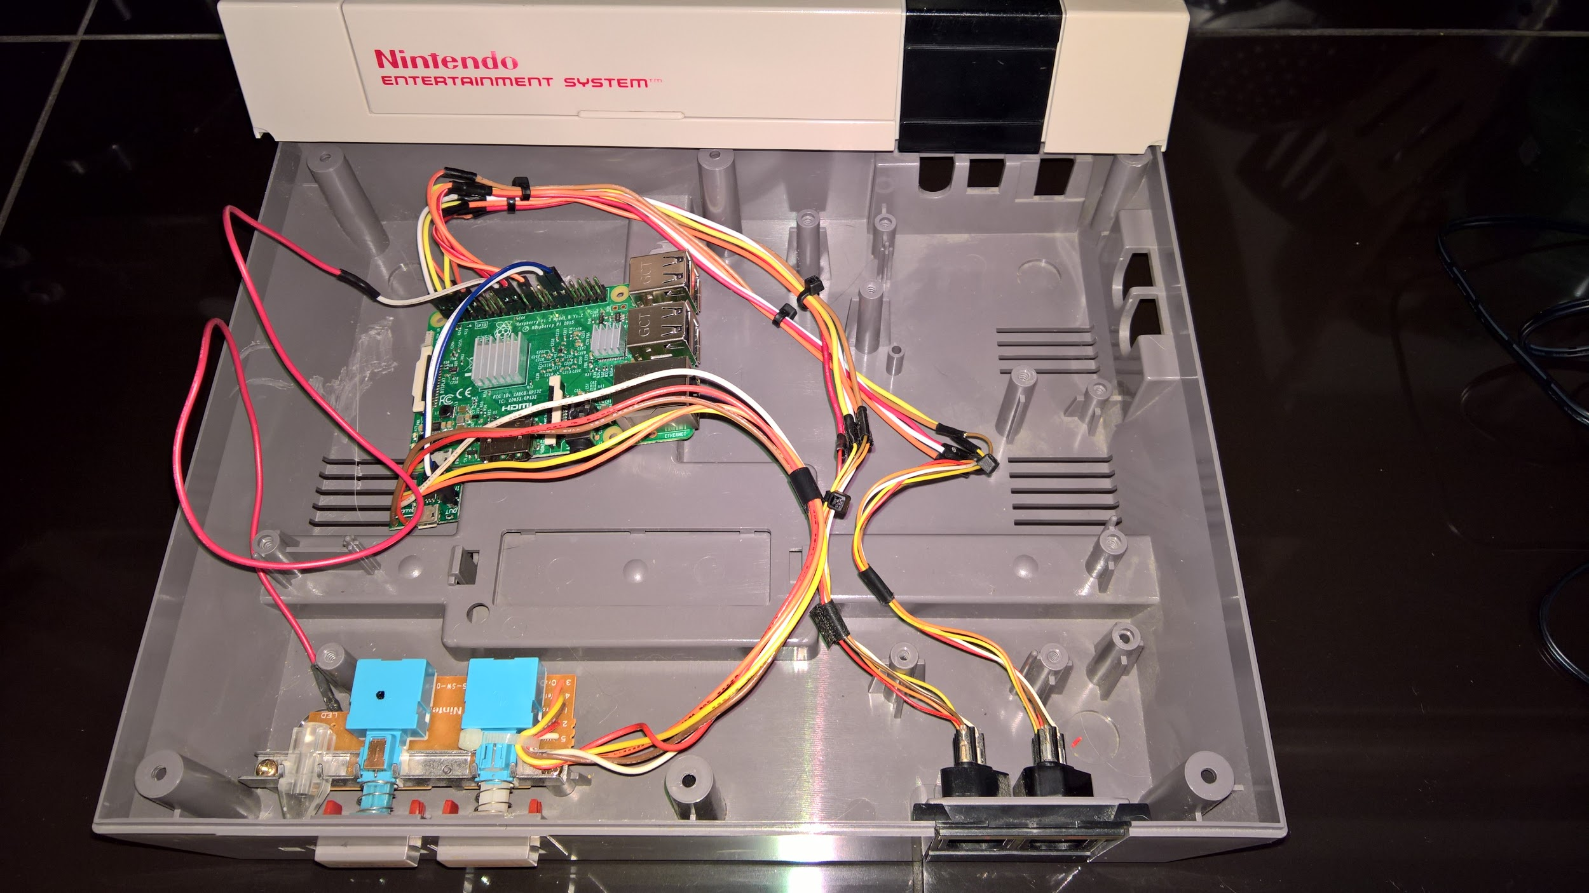

Slide 5
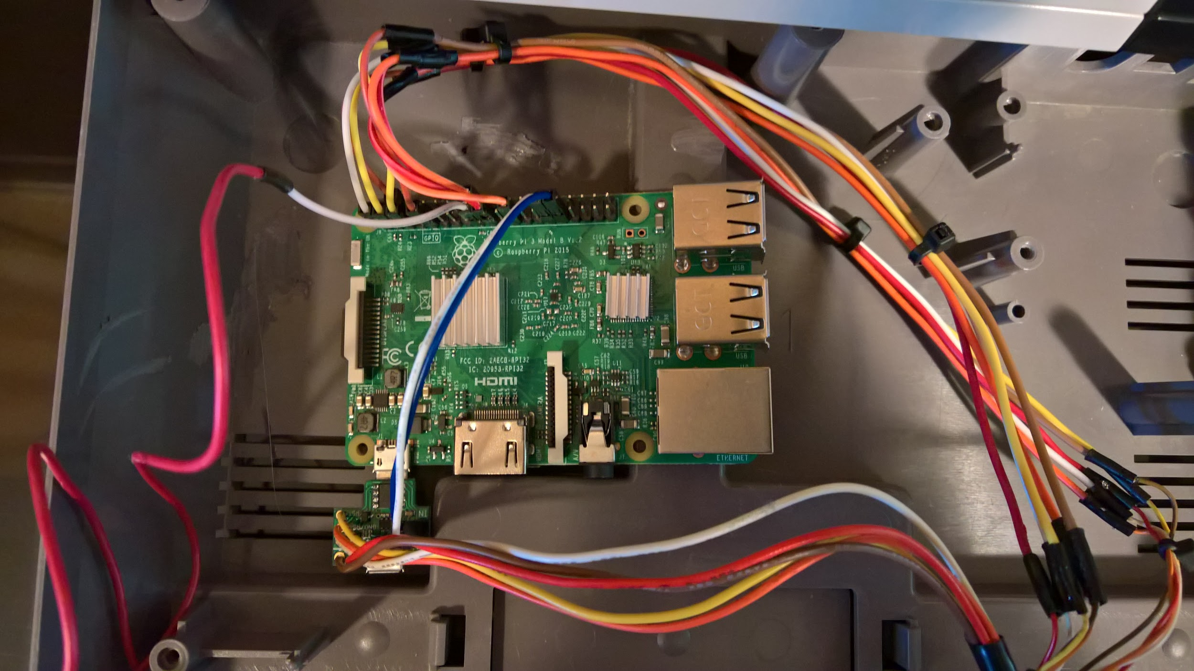

Slide 6
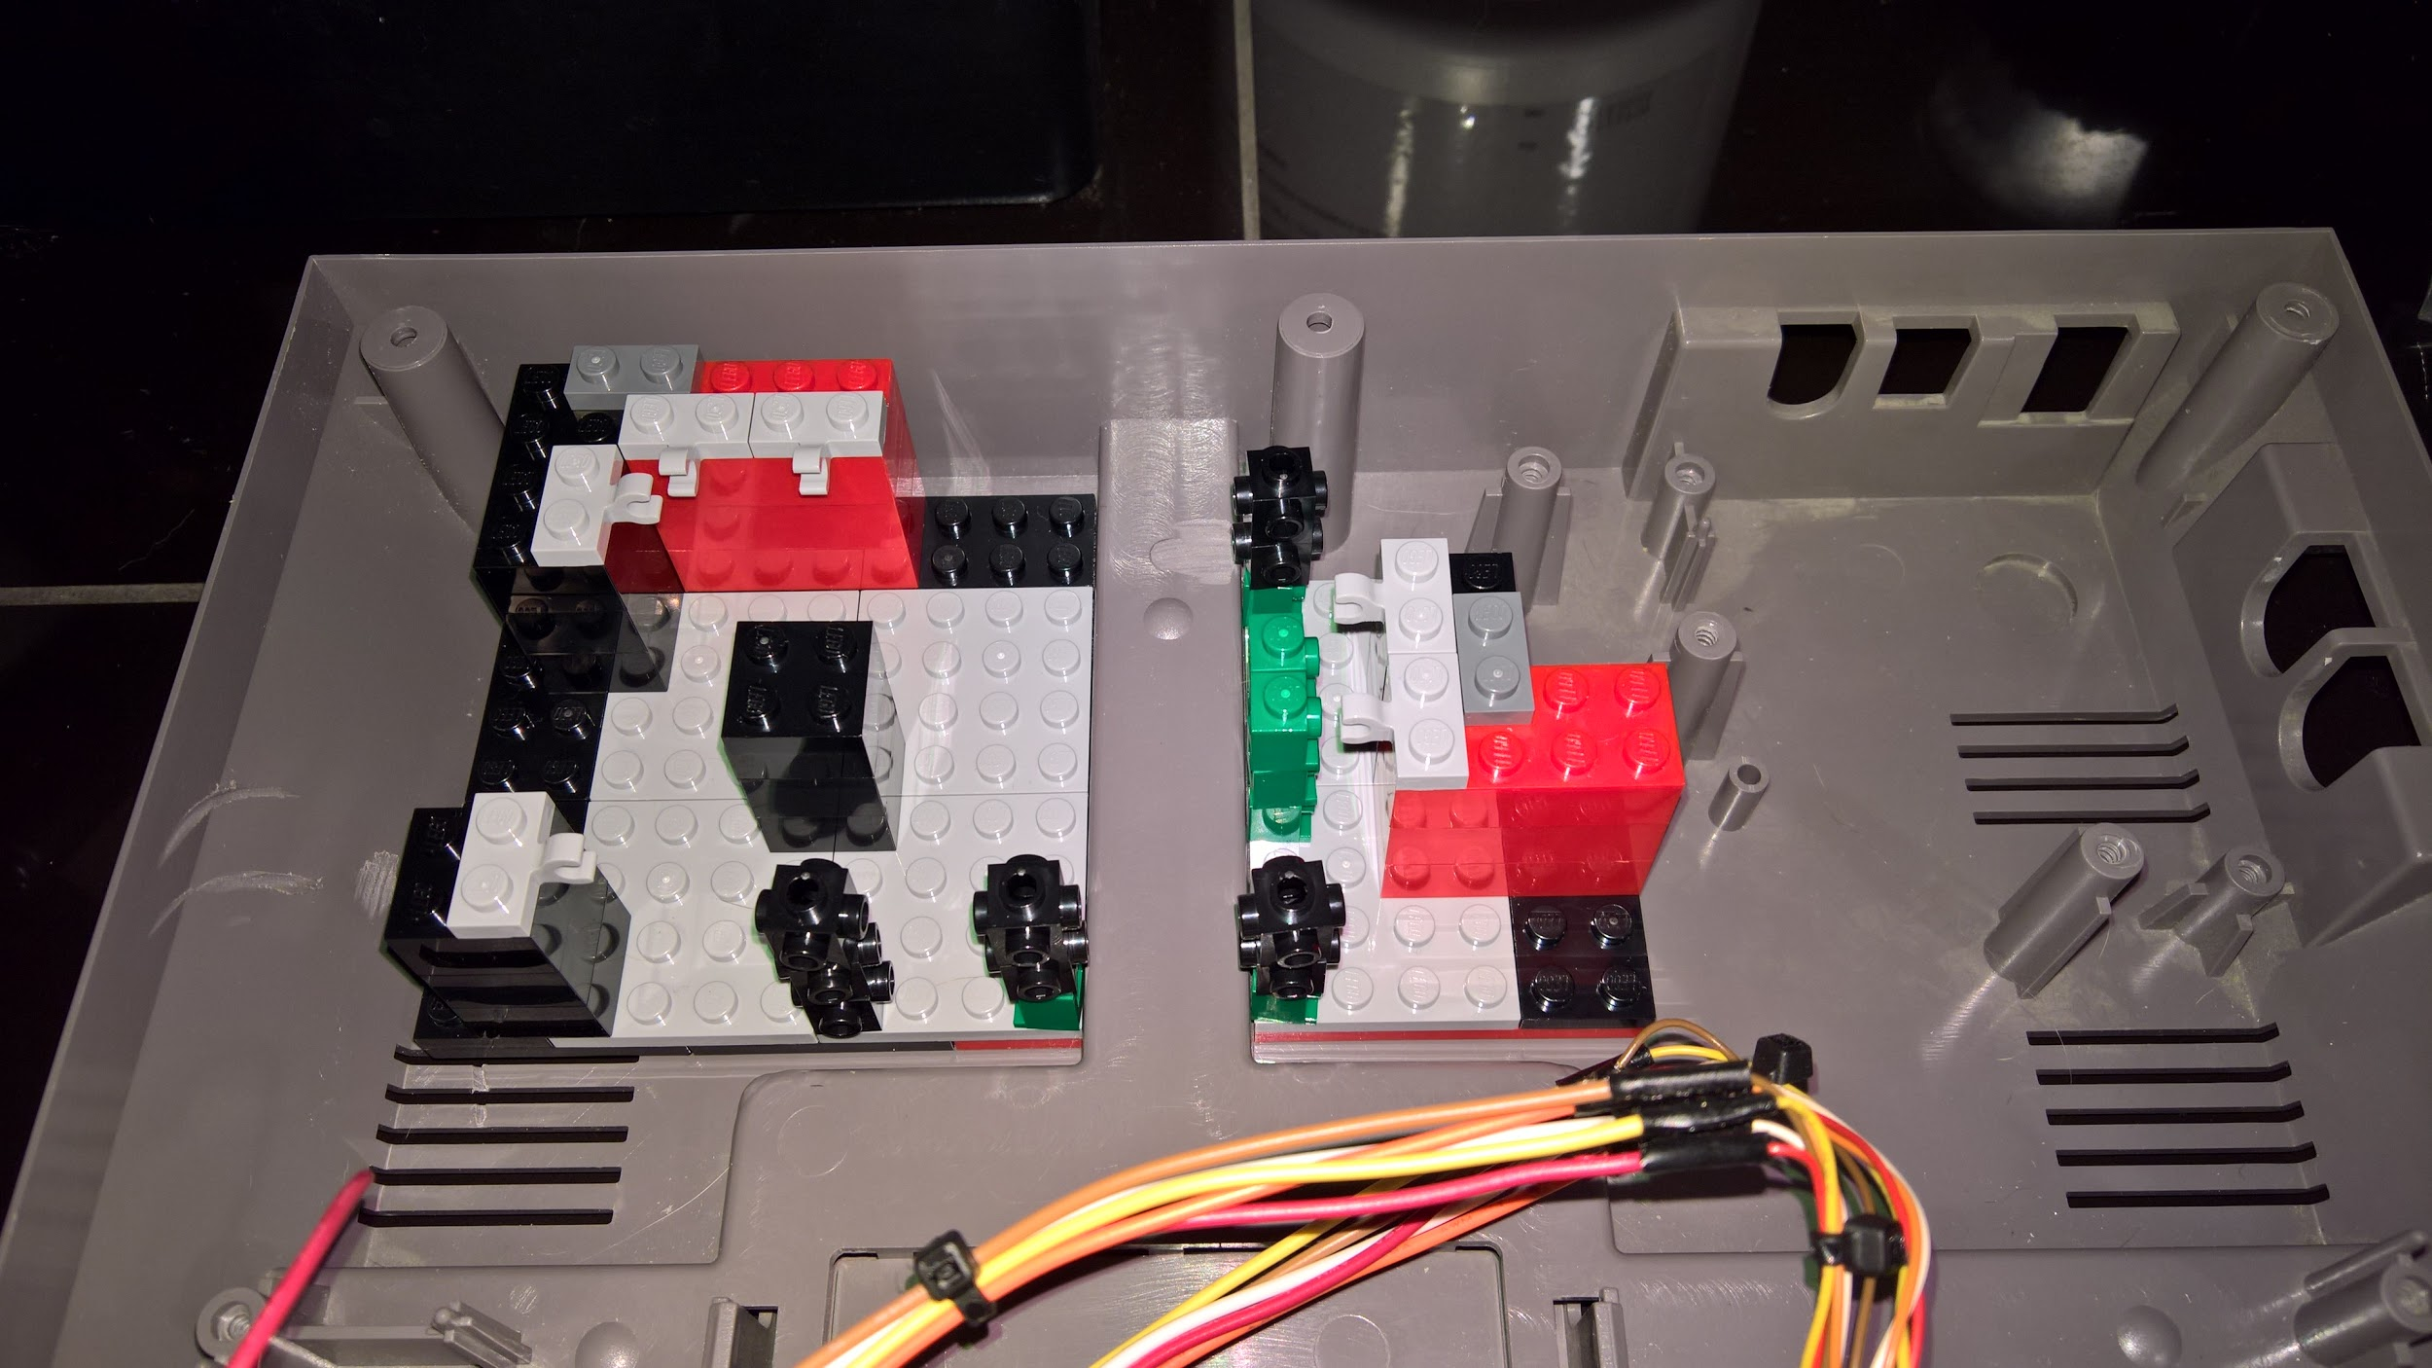

Slide 7
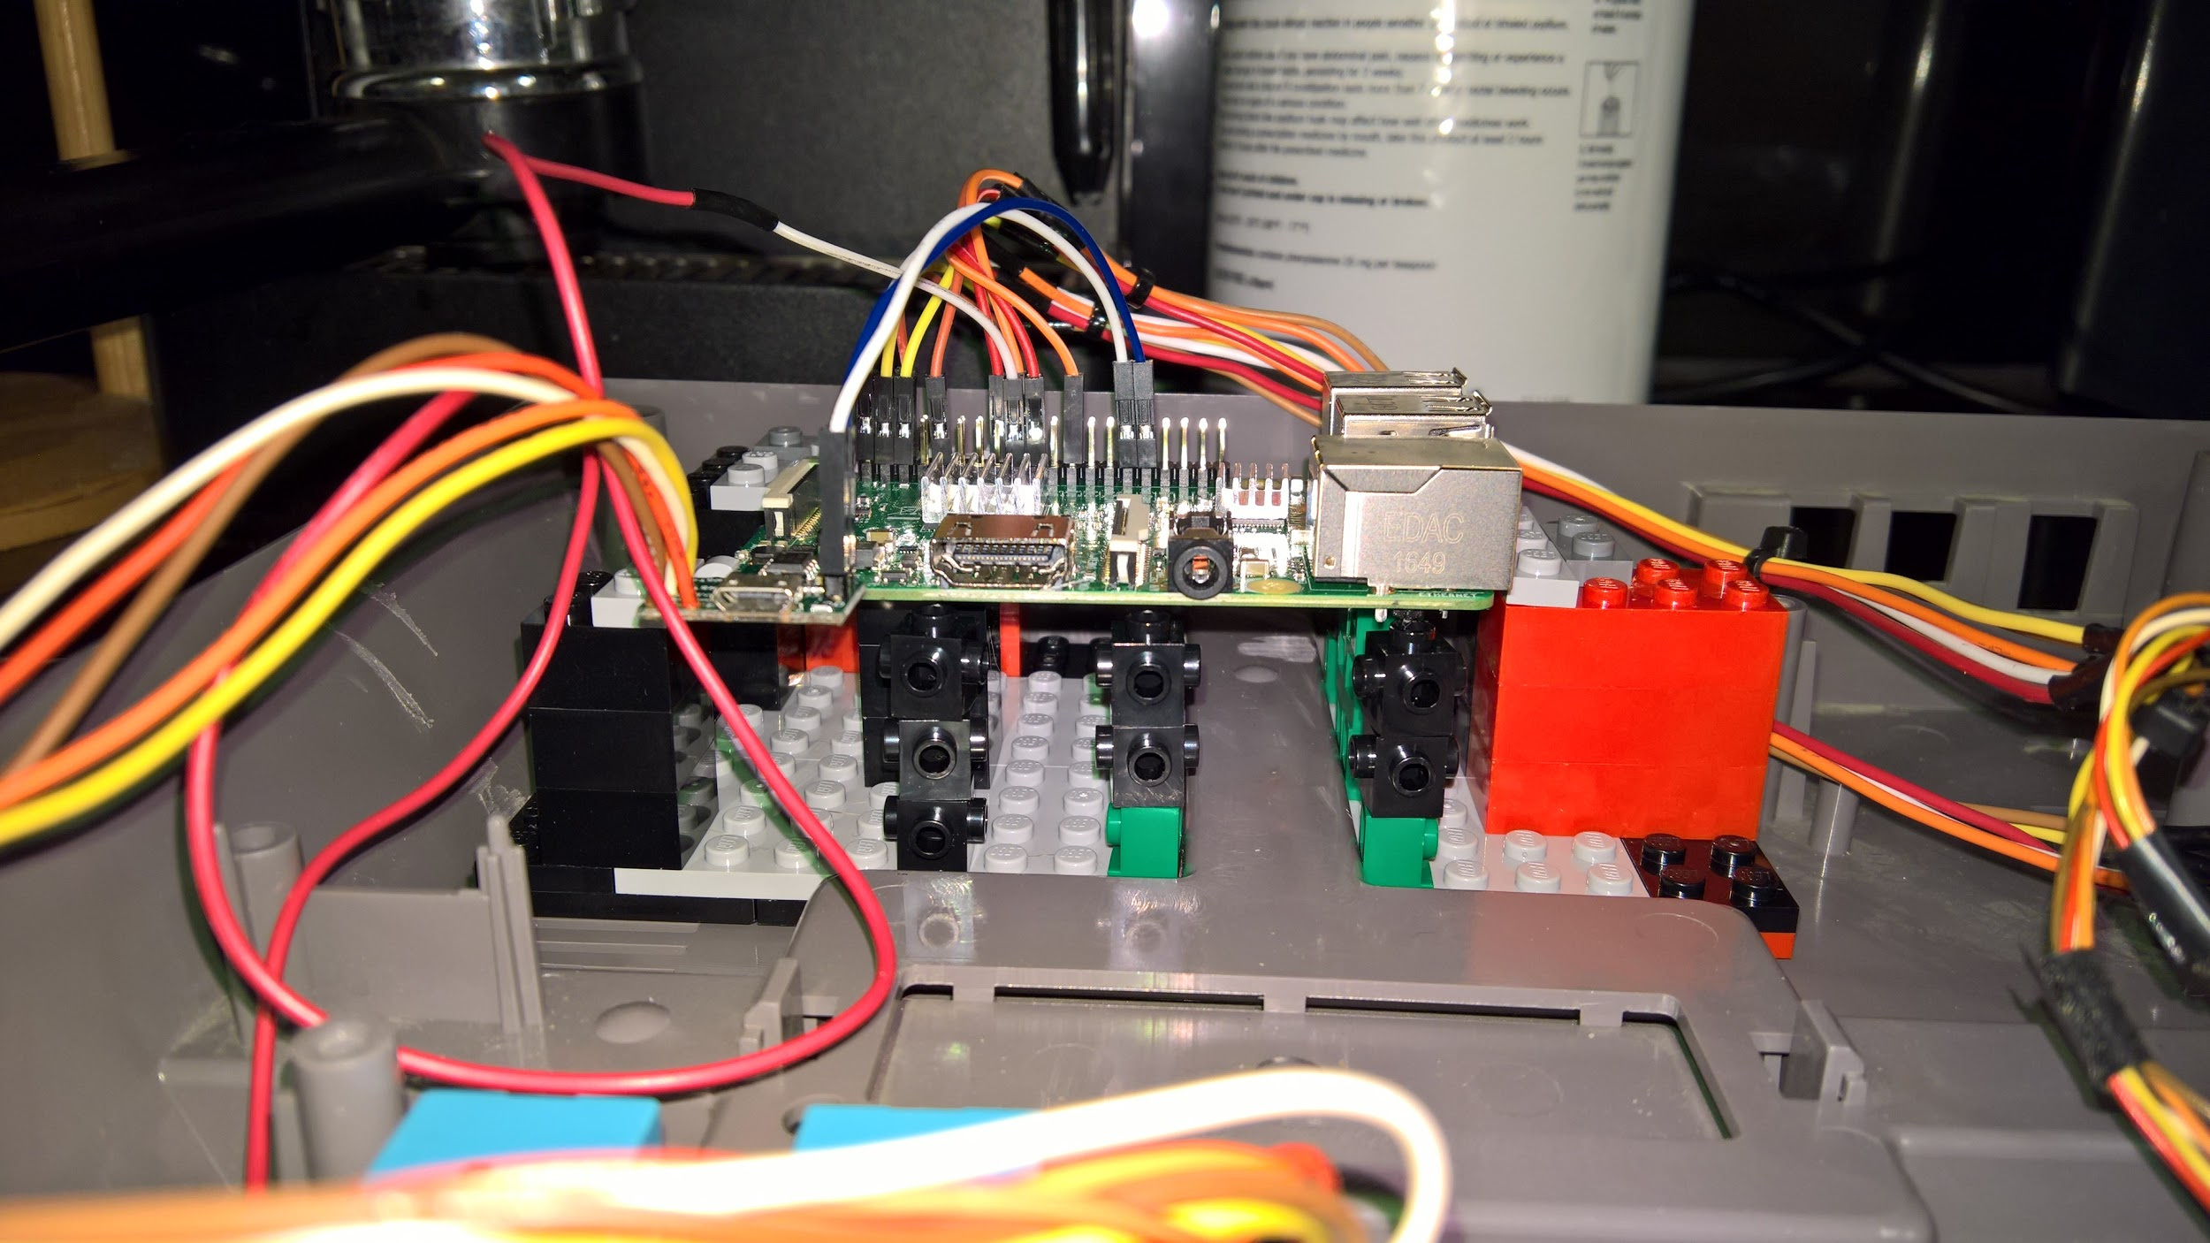

Slide 8
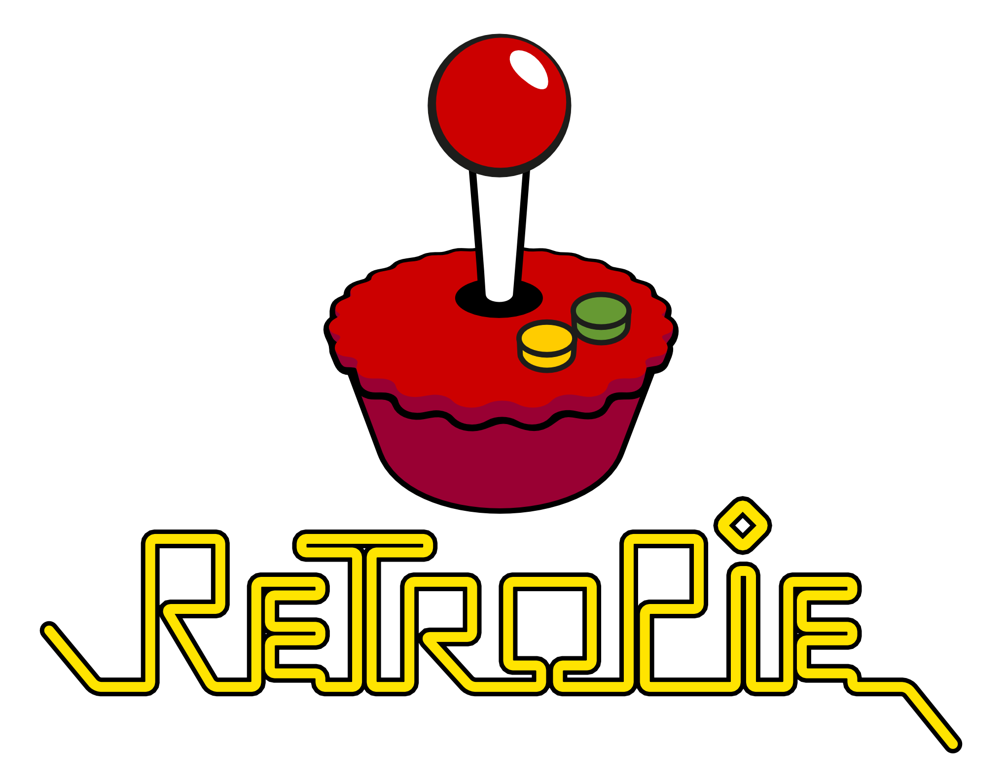
Software Results
RetroPie allows you to turn your Raspberry Pi, ODroid C1/C2, or PC into a retro-gaming machine. It builds upon Raspbian, EmulationStation, RetroArch and many other projects to enable you to play your favourite Arcade, home-console, and classic PC games with the minimum set-up*. For power users it also provides a large variety of configuration tools to customise the system as you want.
RetroPie sits on top of a full OS, you can install it on an existing Raspbian, or start with the RetroPie image and add additional software later. It's up to you.
*Results may vary

Slide 9
Hardware Results
Functional first attempt
Runs various retro systems effectively
Power switch on the NES system functions with the Pi
Pressing button turns on Pi
Depressing button sends shutdown command to Pi and completely cuts power
Original LED functions!
Reset button functions, but is a hard reset (only recommended as a last resort due to risk of corrupting SD card)
Controller ports are wired to GPIO pins, but non-functional due to a driver conflict
Plan on enhancing and expanding after this semester

Slide 10
Issues Encountered
Driver conflict with Linux caused issues with our ability to get the GPIO pins to function with original NES ports; waiting for upstream fix to reattempt
Several missteps with scripts and modifications forced us to take a step back and restore a backup
Conflicts when working with PC vs Mac
Sometimes encountered unusual errors that “sometimes just happen”; can take a while to diagnose and correct (less is more mentality reduces these issues)

Slide 11
Lessons Learned
Less is more; don’t treat like a PC and try to run/install everything unless you love causing problems that are so hard to correct that starting over again is the best option
Backup before doing any installs, updates, or changes (see previous bullet point)
Emulation isn’t a perfect substitute for the real thing and the Pi isn’t the most powerful

Slide 12
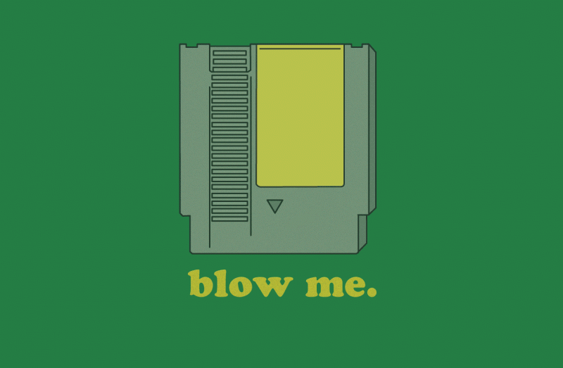
Demo

